Slide 1
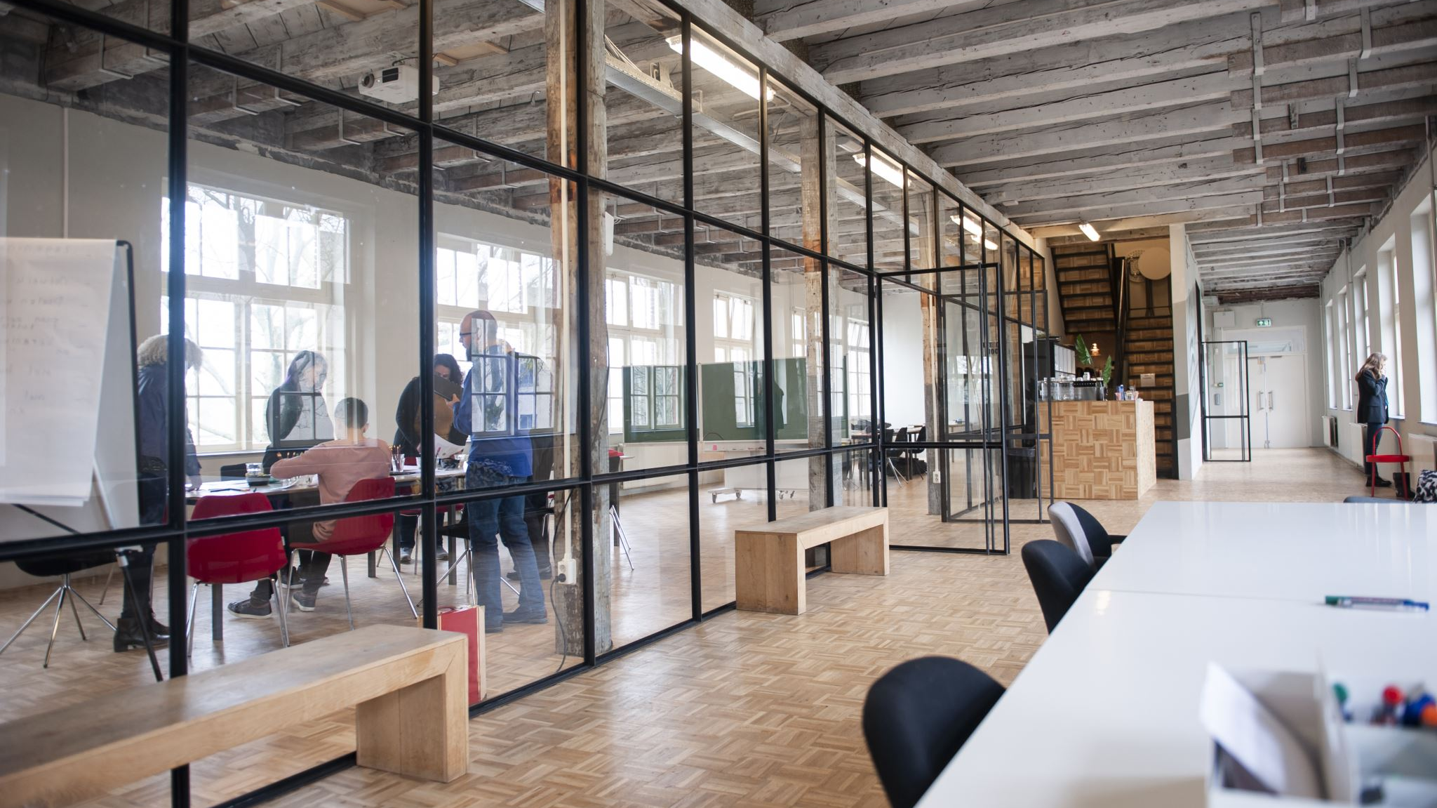
New offices are needed?
New office found!
San Francisco
will fill all of our staff’s needs and wants
This is the data to support this recommendation
Notes:
You recently created a new company in the GAMING industry. The company will have the following scheme:
20 Designers
5 UI/UX Engineers
10 Frontend Developers
15 Data Engineers
5 Backend Developers
20 Account Managers
1 Maintenance guy that loves basketball
10 Executives
1 CEO/President.

Slide 2
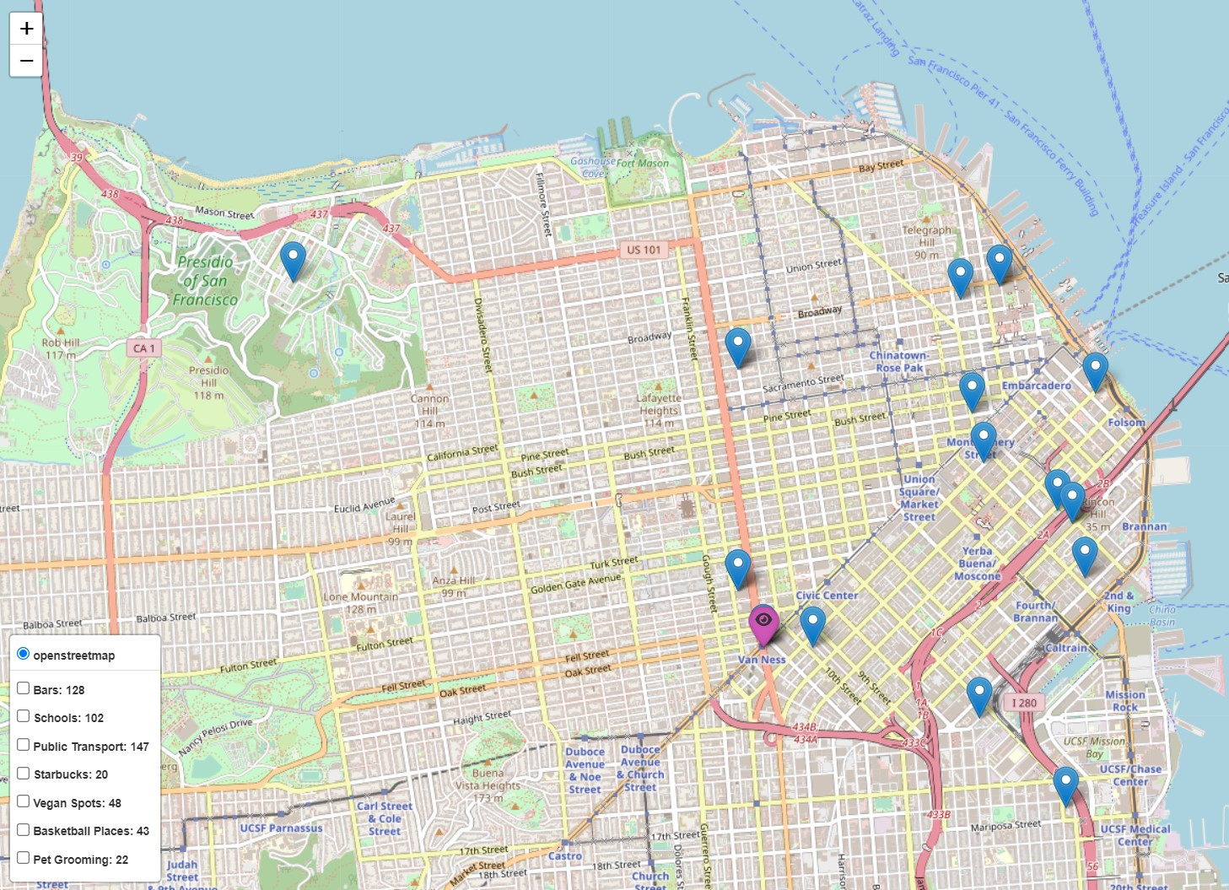
San Francisco was selected through querying over the Crunchbase database.
The business environment:
DESIGN companies
&
Tech startups
Notes:
Query the database OK
Get df for design OK
Get df for tech 1M+ OK
Clean money raised in df tech OK
Clean offices in df design OK
Clean offices in df tech OK
Sort both df’s by city OK

Slide 3
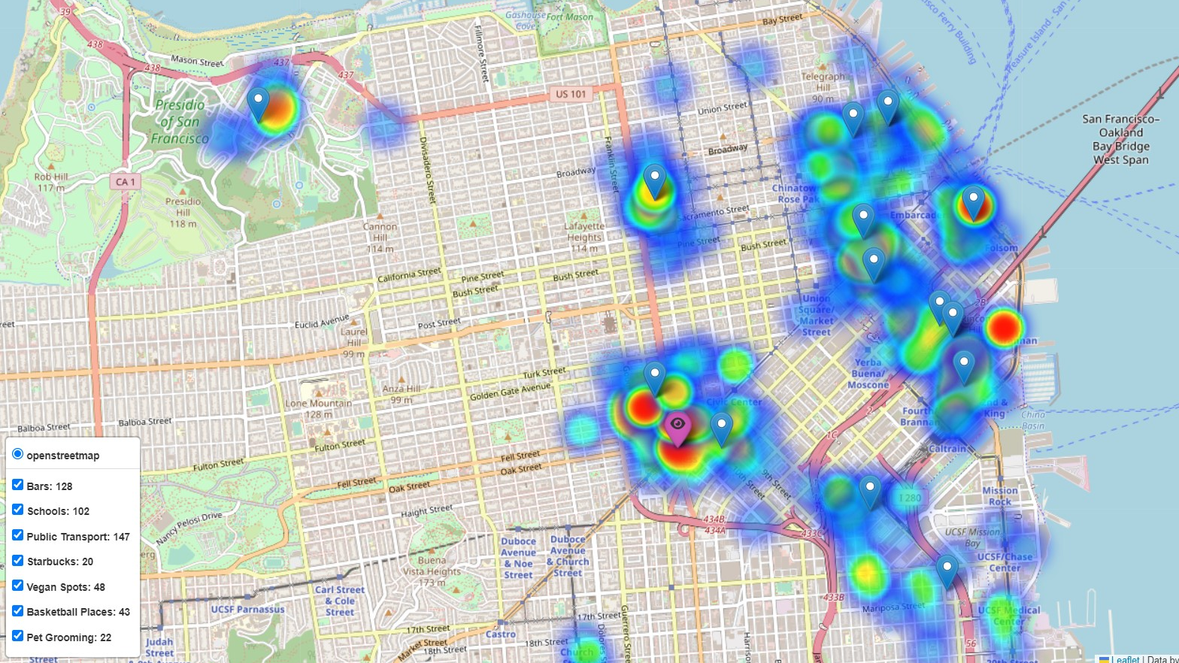
San Francisco a vibrating city where business and creativity blend into everyday life
Notes:
Use an API to get venues (and for this, you'll need a starting point; some coordinates from which you will call the API)
Buscar cada venue para todas las compañías de SF.
Actualizar la table final
Ordenar según peso (prioridades) para ELEGIR la locación a robar.

Slide 4
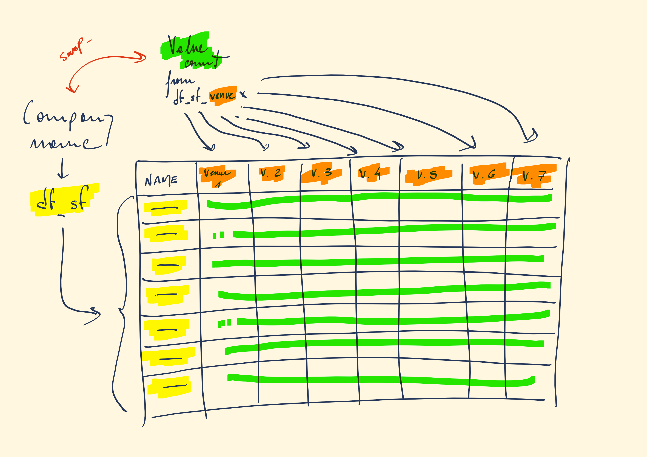
Crossing
SELECTED COMPANIES
From Crunchbase database
with
7 types of VENUE
nearby each COMPANY, according to surveys on our team.
What are their needs and wants?
Notes:
Designers like to go to design talks and share knowledge. There must be some nearby companies that also do design.
30% of the company staff have at least 1 child.
Developers like to be near successful tech startups that have raised at least 1 Million dollars.
Executives like Starbucks A LOT. Ensure there's a starbucks not too far.
Account managers need to travel a lot.
Everyone in the company is between 25 and 40, give them some place to go party.
The CEO is vegan.
If you want to make the maintenance guy happy, a basketball stadium must be around 10 Km.
The office dog—"Dobby" needs a hairdresser every month. Ensure there's one not too far away.

Slide 5
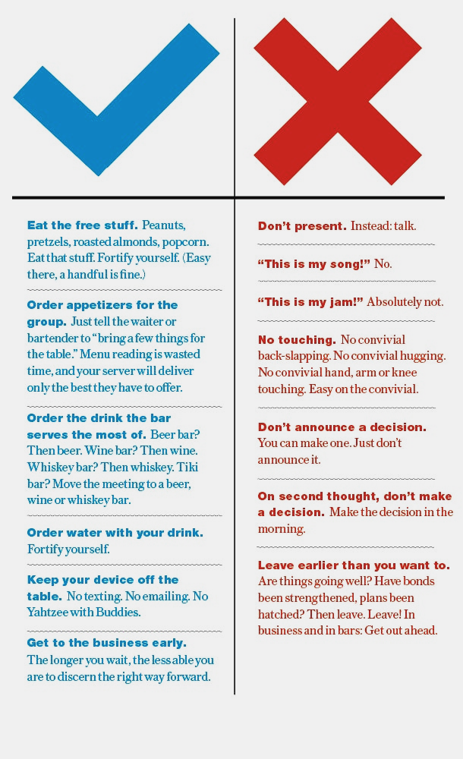
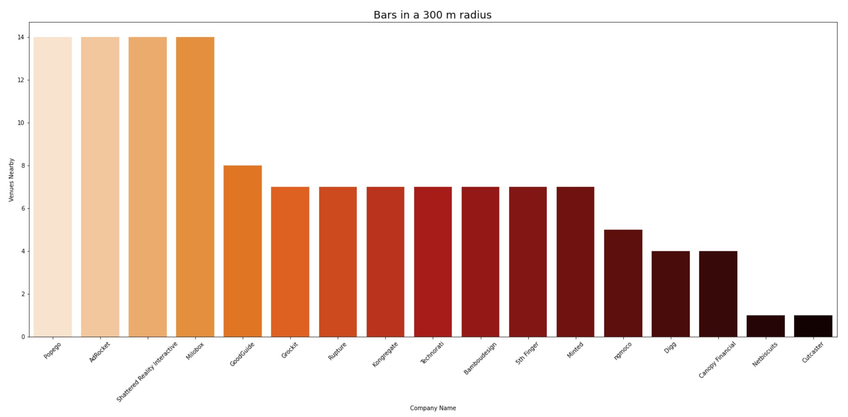

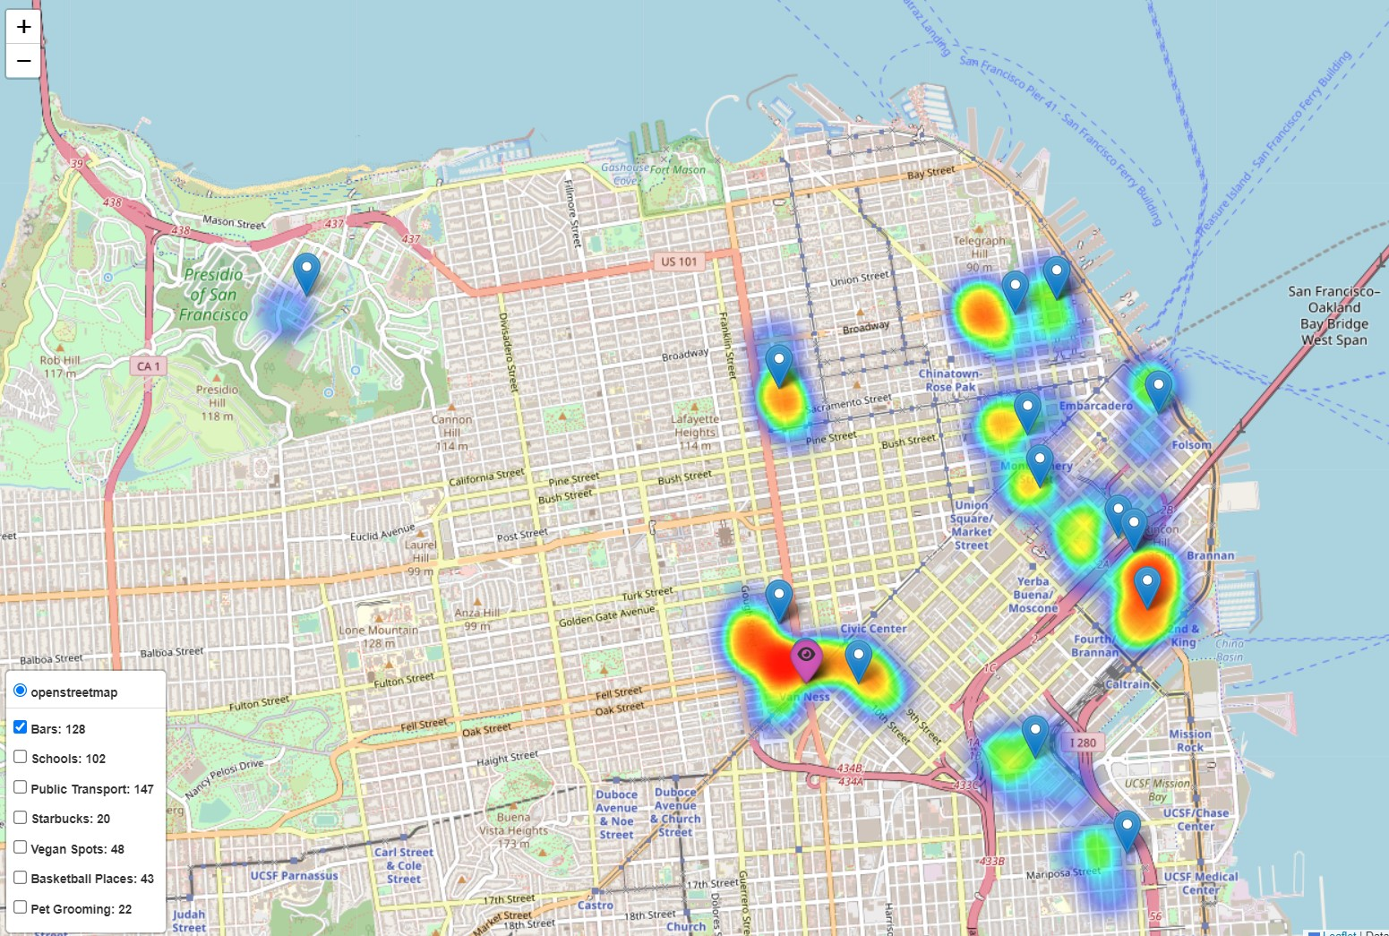
Holding your next meeting in a BAR?
Be savvy. Make sure you're social, but professional. These tips can help.
https://www.entrepreneur.com/leadership/the-dos-and-donts-of-doing-business-in-a-bar-infographic/277820
Notes:
Justify your decision using data, not just visualization. How? Maybe measuring distances, maybe assinging weights depending on the importance of your criteria, maybe calculating the density of schools/Starbucks, etc.
Option A
From the existing companies, choose one to steal their current venue 🥷: query and filter the database based on some of your criteria. Then use an API to do queries (from those companies) and check the companies' surroundings to check the other criteria.
Your result will be coordinates.

Slide 6
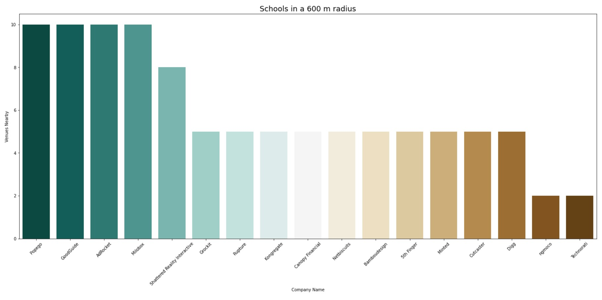


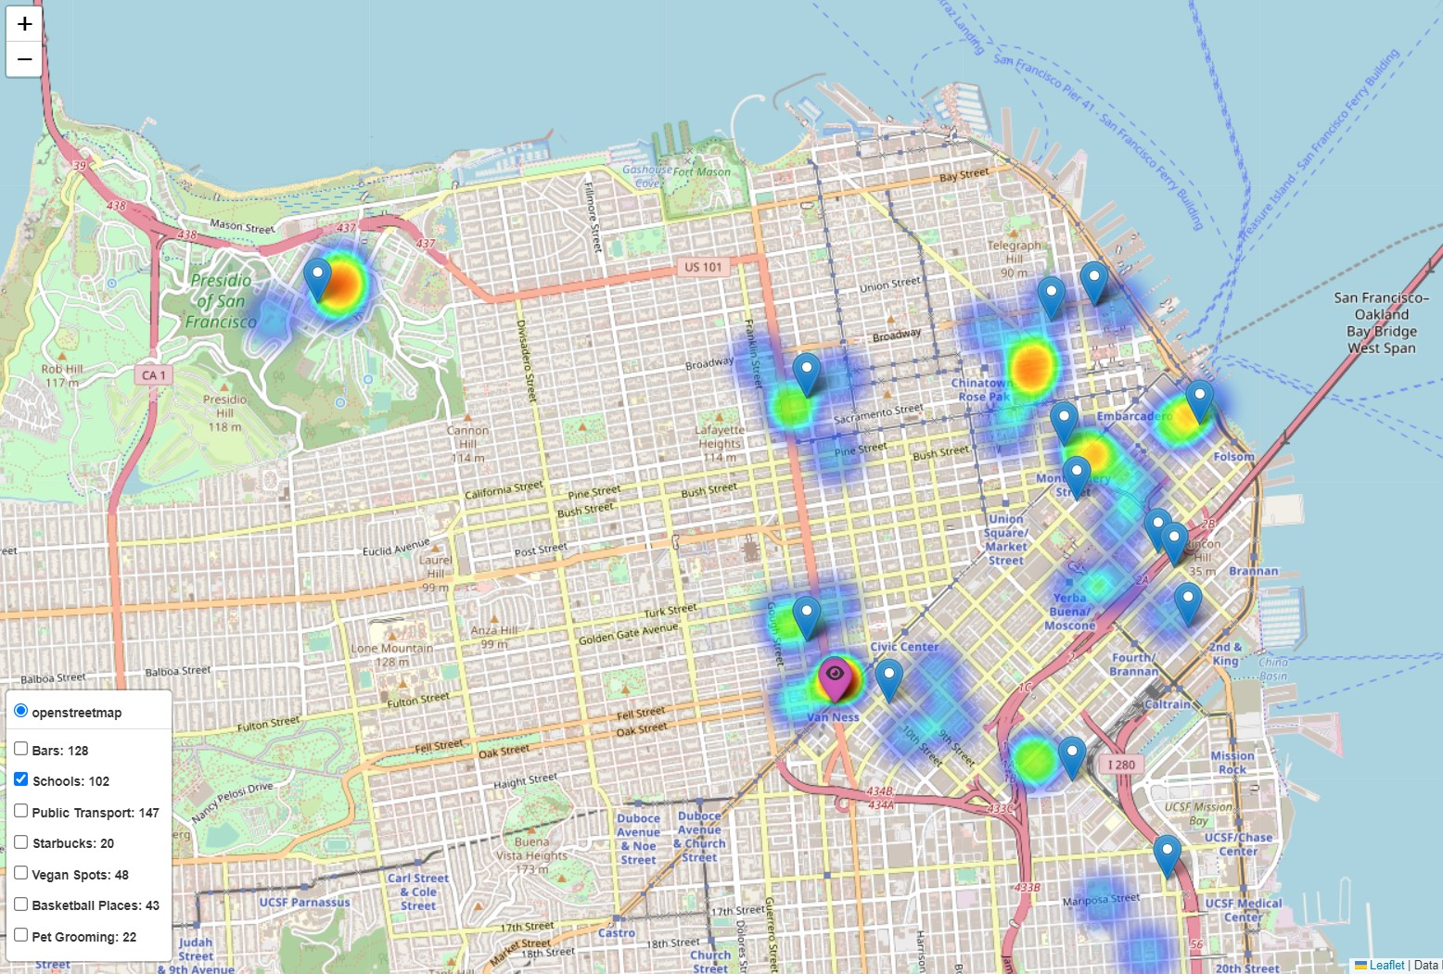
Schools
Caring for time and quality environment is clearly reflected on this decision:
Nearby schools are key for every family and their time management.
Notes:
Justify your decision using data, not just visualization. How? Maybe measuring distances, maybe assinging weights depending on the importance of your criteria, maybe calculating the density of schools/Starbucks, etc.
Option A
From the existing companies, choose one to steal their current venue 🥷: query and filter the database based on some of your criteria. Then use an API to do queries (from those companies) and check the companies' surroundings to check the other criteria.
Your result will be coordinates.

Slide 7
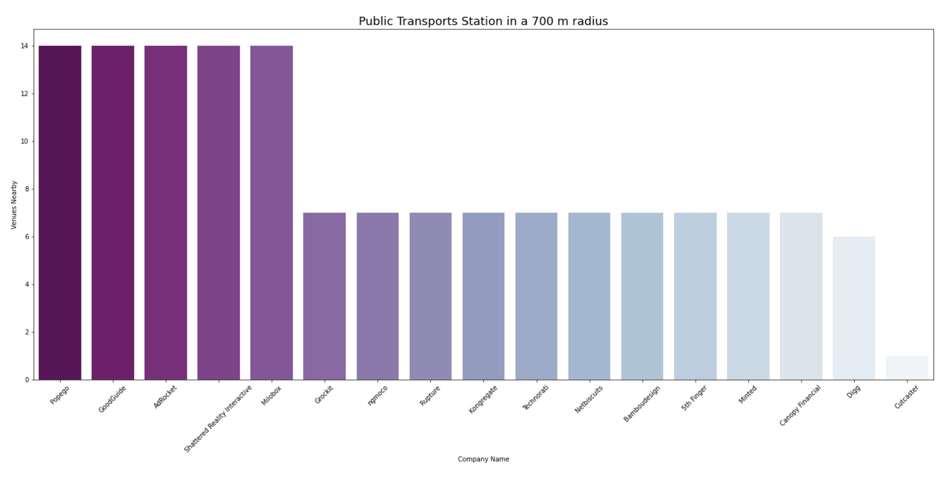
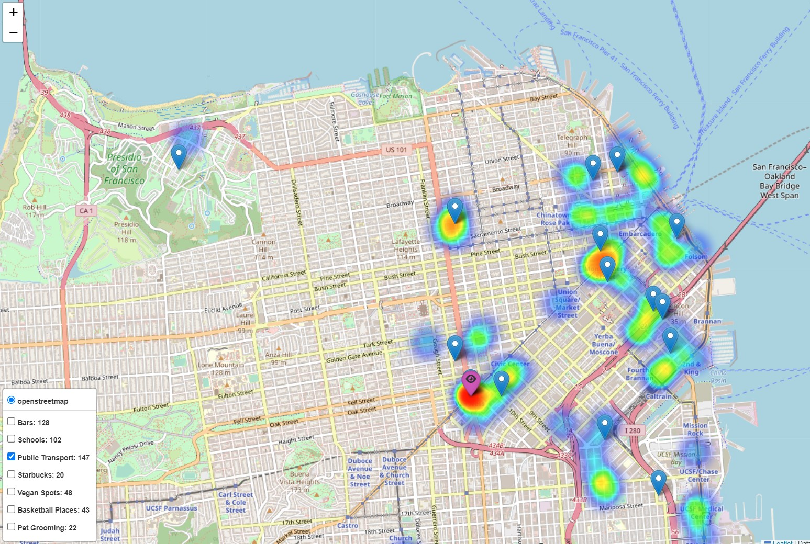

transportation
accesibilty
Notes:
Justify your decision using data, not just visualization. How? Maybe measuring distances, maybe assinging weights depending on the importance of your criteria, maybe calculating the density of schools/Starbucks, etc.
Option A
From the existing companies, choose one to steal their current venue 🥷: query and filter the database based on some of your criteria. Then use an API to do queries (from those companies) and check the companies' surroundings to check the other criteria.
Your result will be coordinates.

Slide 8
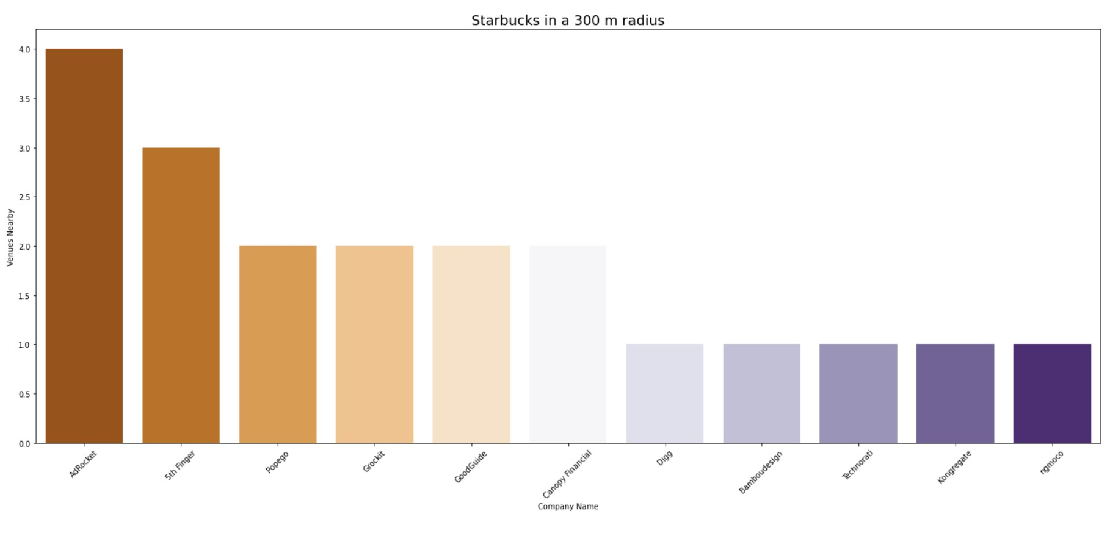
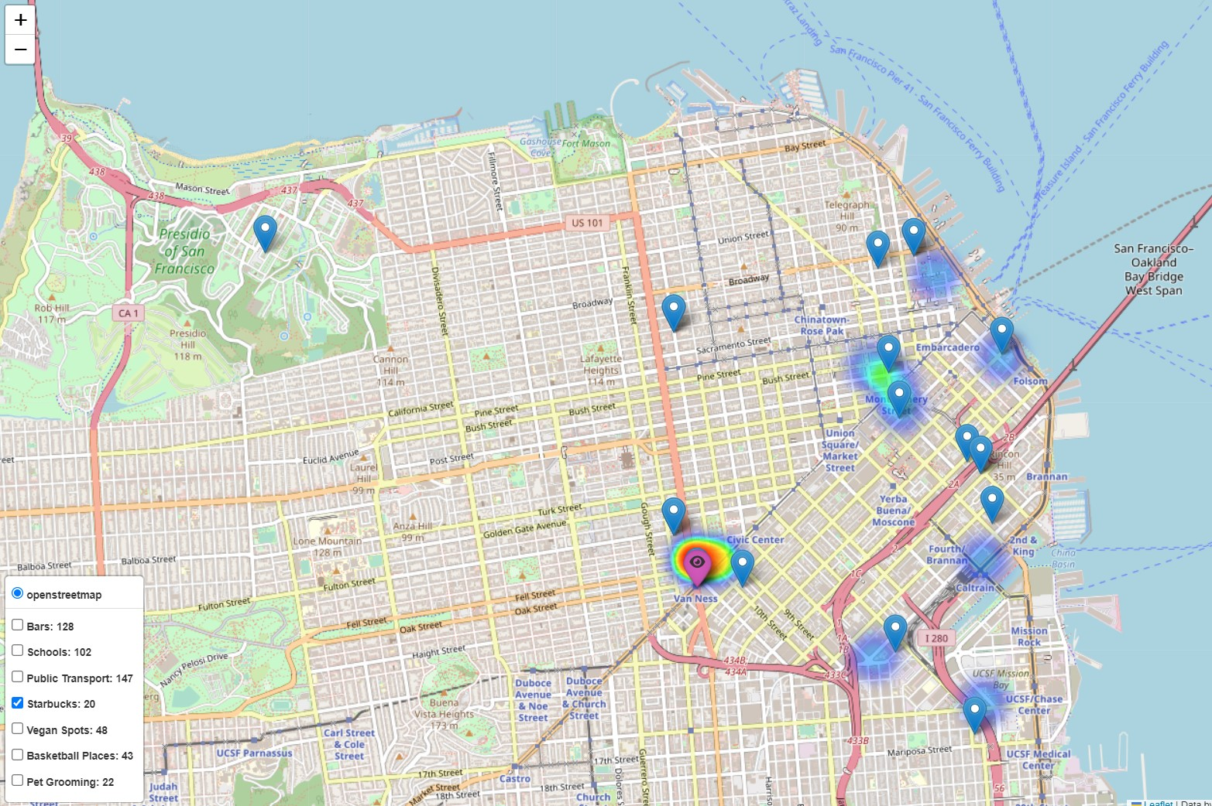


Starbucks
Notes:
Justify your decision using data, not just visualization. How? Maybe measuring distances, maybe assinging weights depending on the importance of your criteria, maybe calculating the density of schools/Starbucks, etc.
Option A
From the existing companies, choose one to steal their current venue 🥷: query and filter the database based on some of your criteria. Then use an API to do queries (from those companies) and check the companies' surroundings to check the other criteria.
Your result will be coordinates.

Slide 9
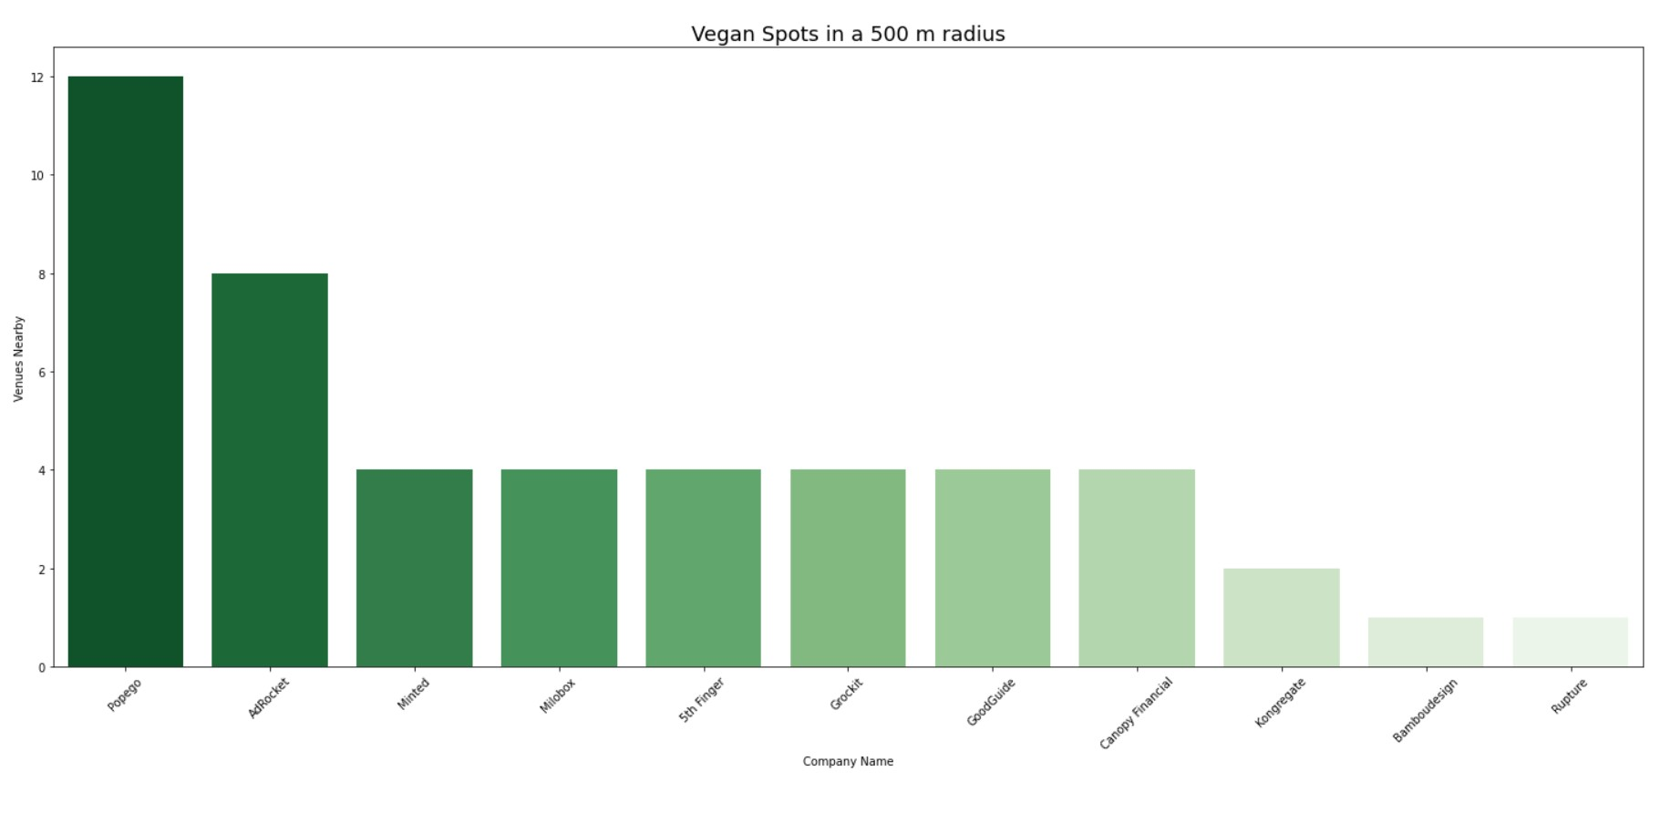
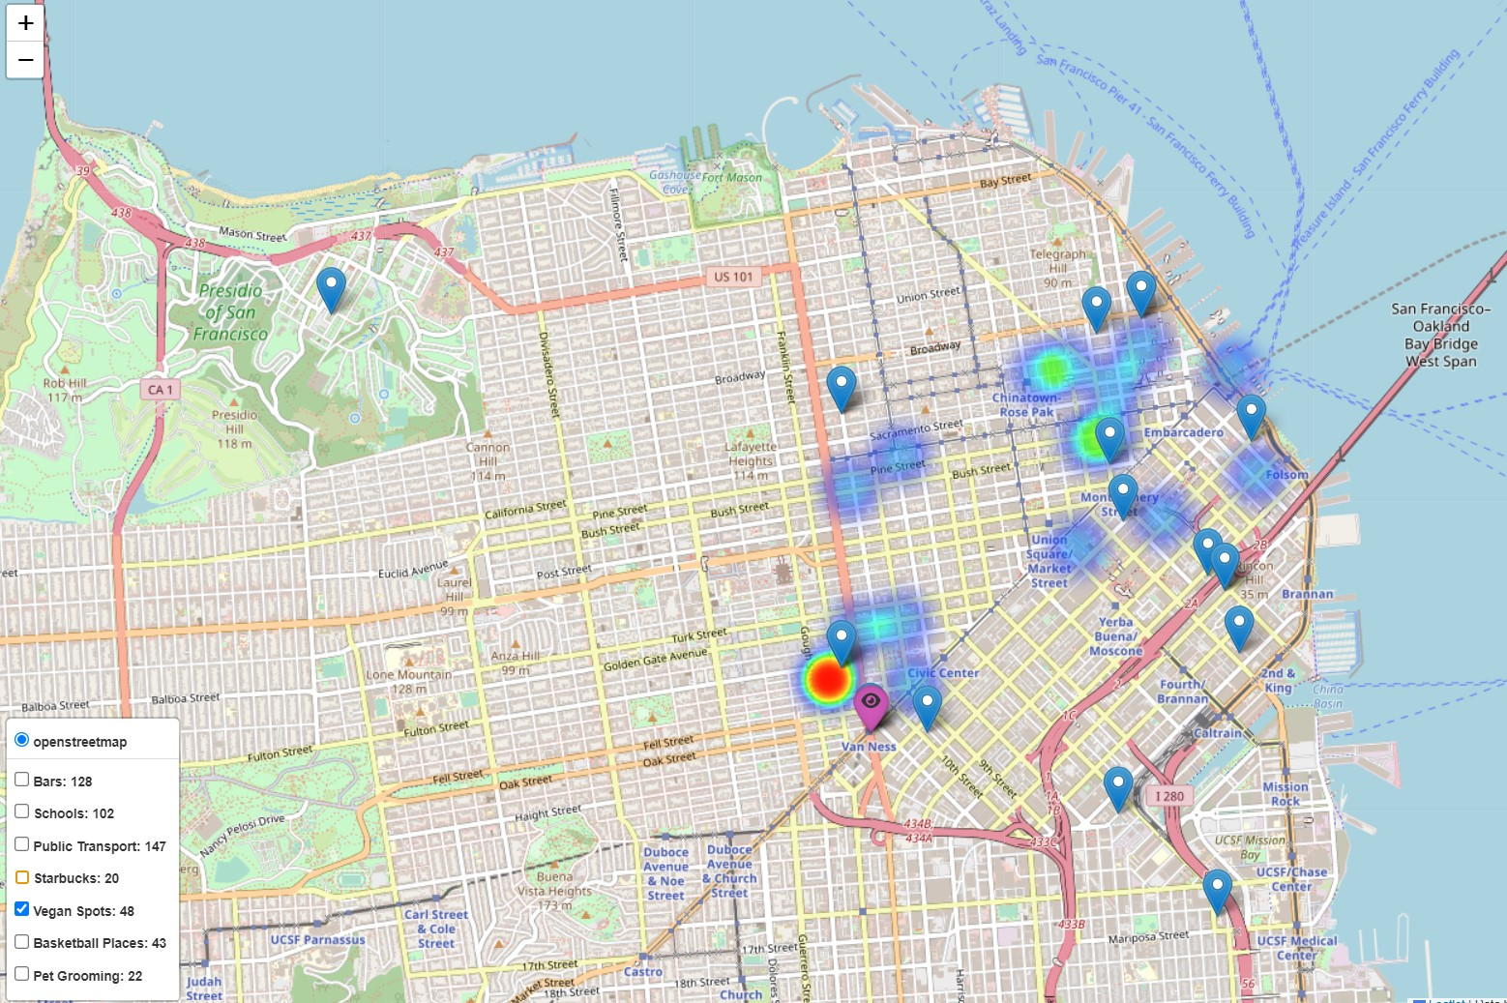

vegan restaurants
Notes:
Justify your decision using data, not just visualization. How? Maybe measuring distances, maybe assinging weights depending on the importance of your criteria, maybe calculating the density of schools/Starbucks, etc.
Option A
From the existing companies, choose one to steal their current venue 🥷: query and filter the database based on some of your criteria. Then use an API to do queries (from those companies) and check the companies' surroundings to check the other criteria.
Your result will be coordinates.

Slide 10
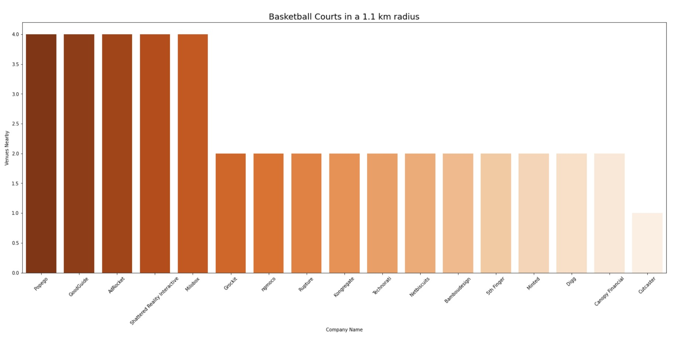

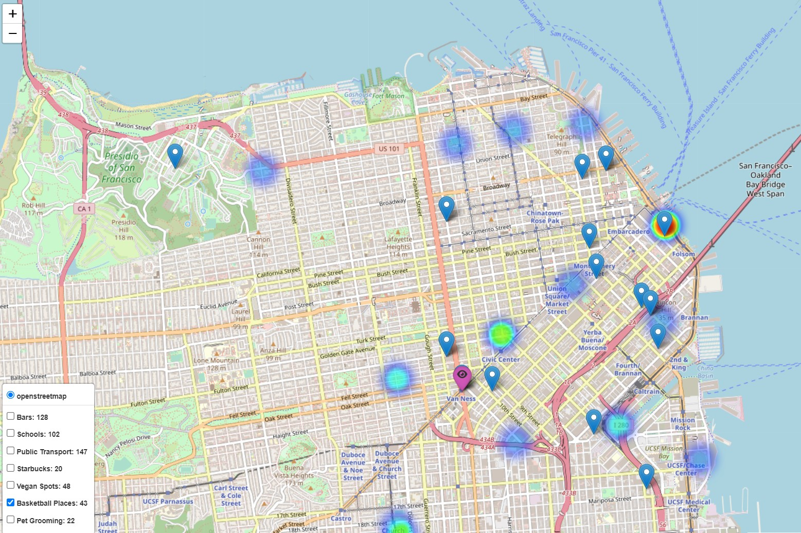
Basketball Courts
Notes:
Justify your decision using data, not just visualization. How? Maybe measuring distances, maybe assinging weights depending on the importance of your criteria, maybe calculating the density of schools/Starbucks, etc.
Option A
From the existing companies, choose one to steal their current venue 🥷: query and filter the database based on some of your criteria. Then use an API to do queries (from those companies) and check the companies' surroundings to check the other criteria.
Your result will be coordinates.

Slide 11

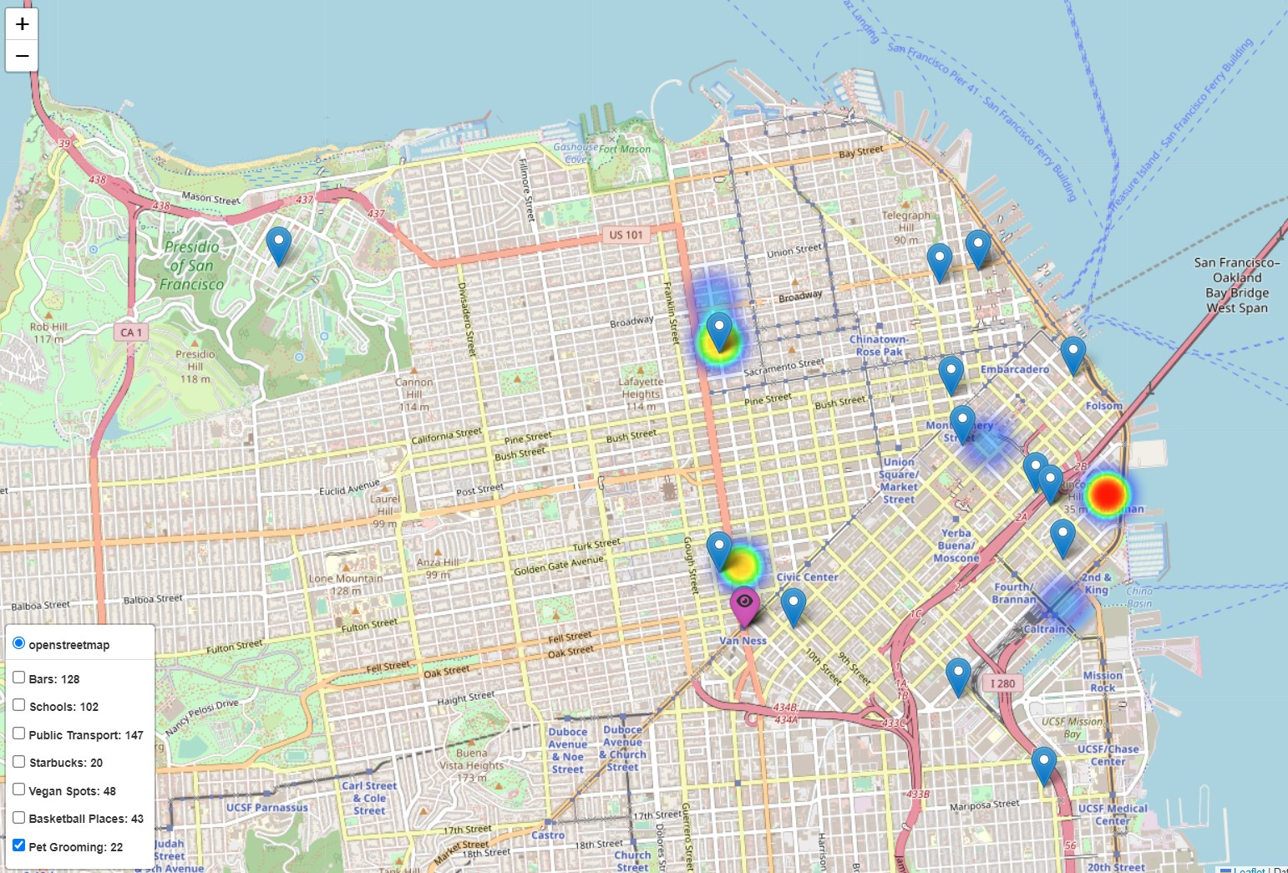
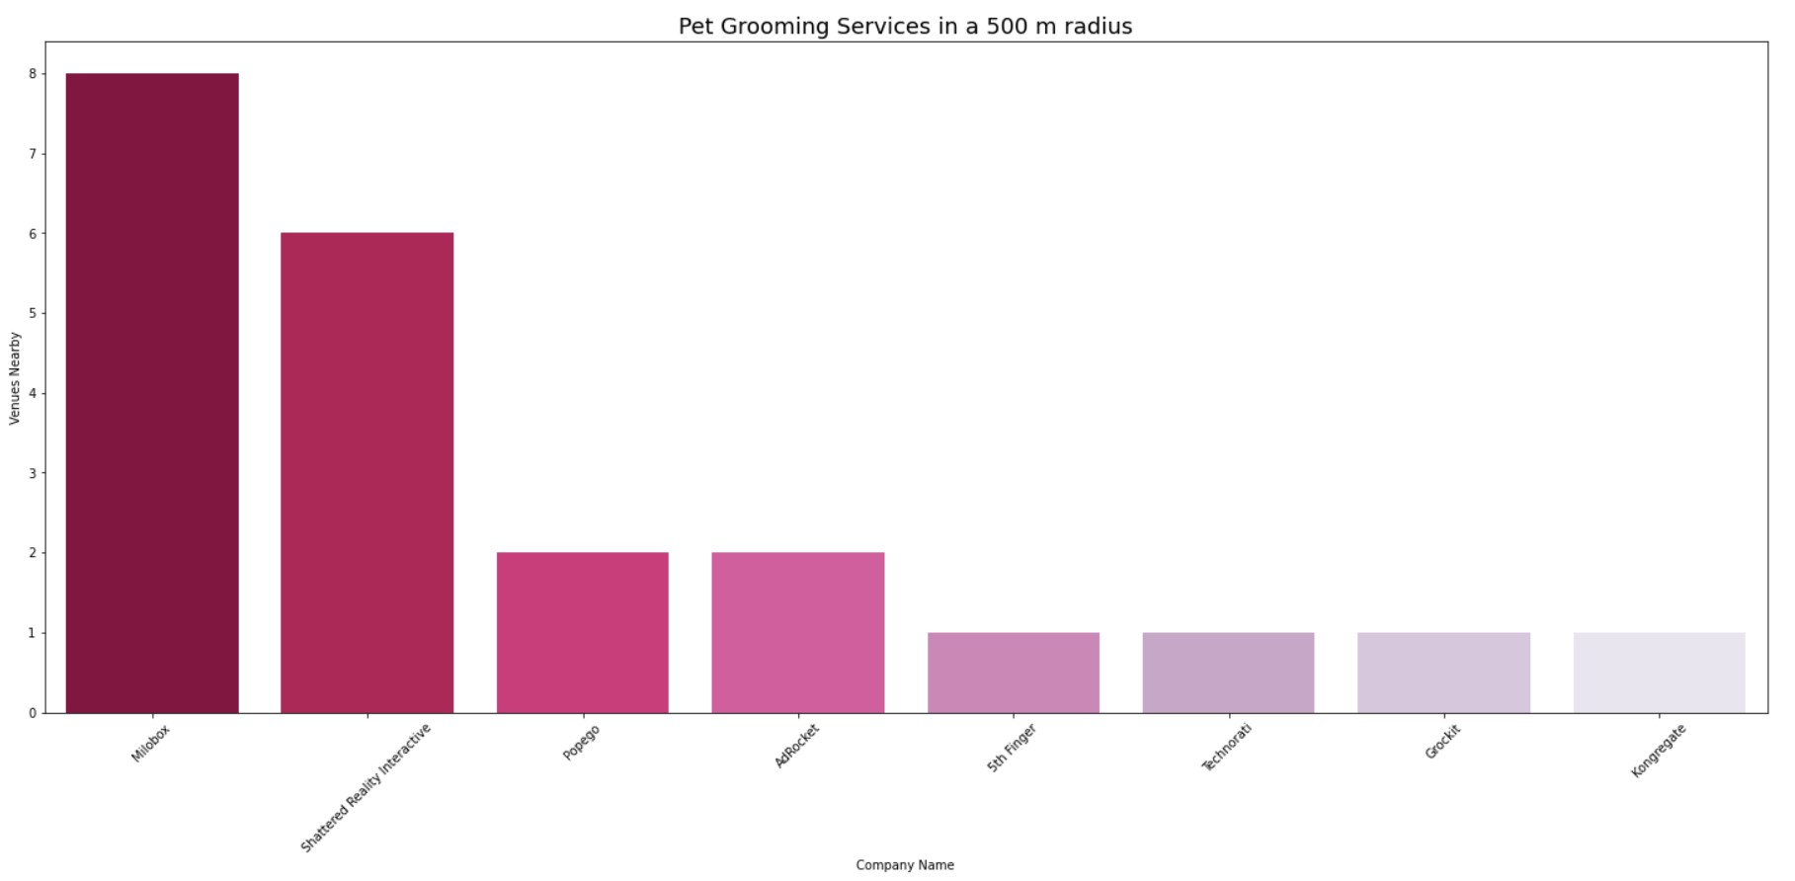
Pet Gromming services around the new office
Notes:
BONUS
You found a perfect location for your company: but it's either taken by another company or there's too many options in the city you chose. After all, a whole city is not too specific.
Web scrape real state sites 🏠 to get the best prices and choose a neighbourhood, a block or an adress.
Help
Always use standard GeoJSON Point { type: "Point", coordinates: [ 40, 5 ] }
Create sphere2d index in python with pymongo: db.collection.createIndex( { <location field> : "2dsphere" } )
MongoDB $near operator: https://docs.mongodb.com/manual/reference/operator/query/near/#op._S_near

Slide 12
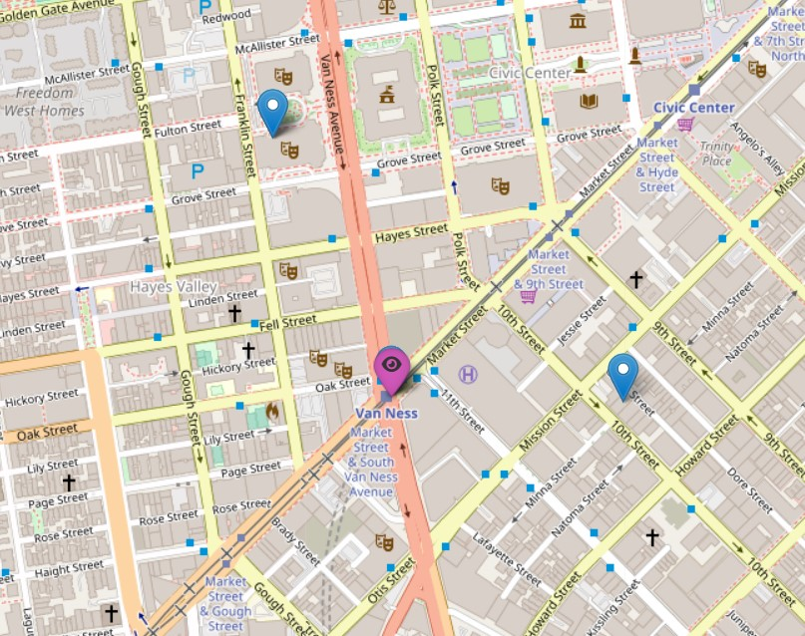
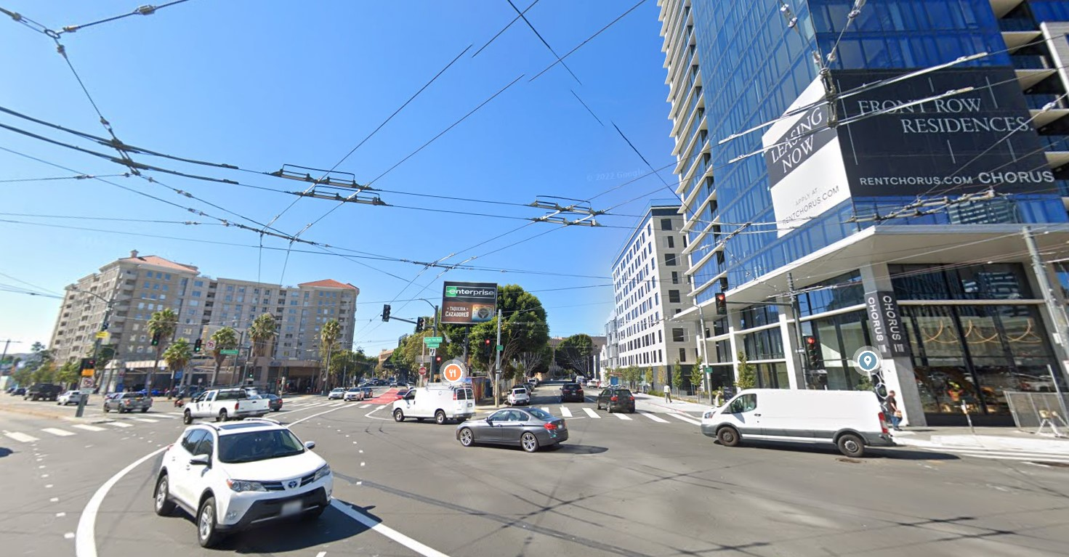
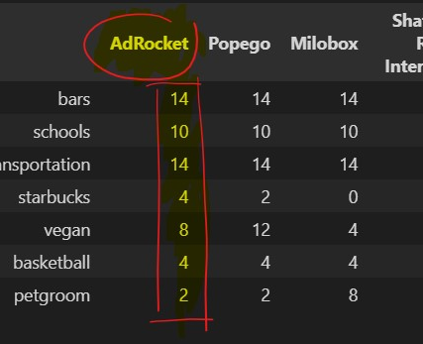
We’re taking over the AdRocket location!

